Slide 1

Sensor Kit (Kit 1)
ZAS Robotics Training

Slide 2



Sensor Kit - Contents
Sensor Kit Components
Sensor Creative Board

Slide 3



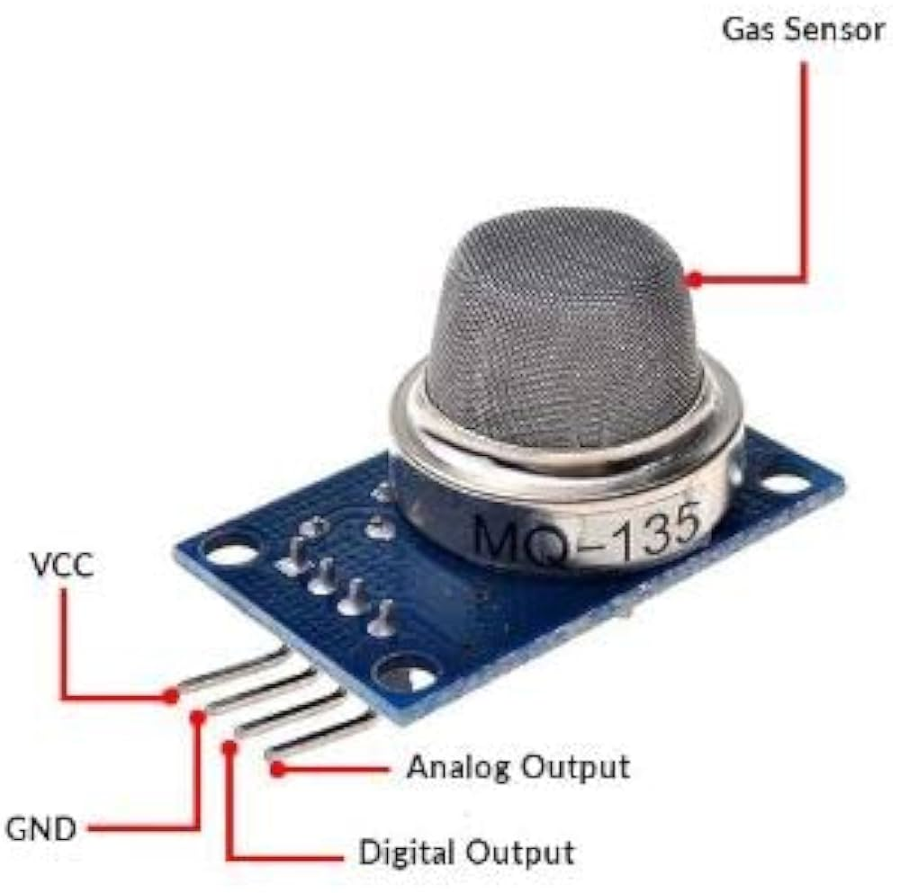

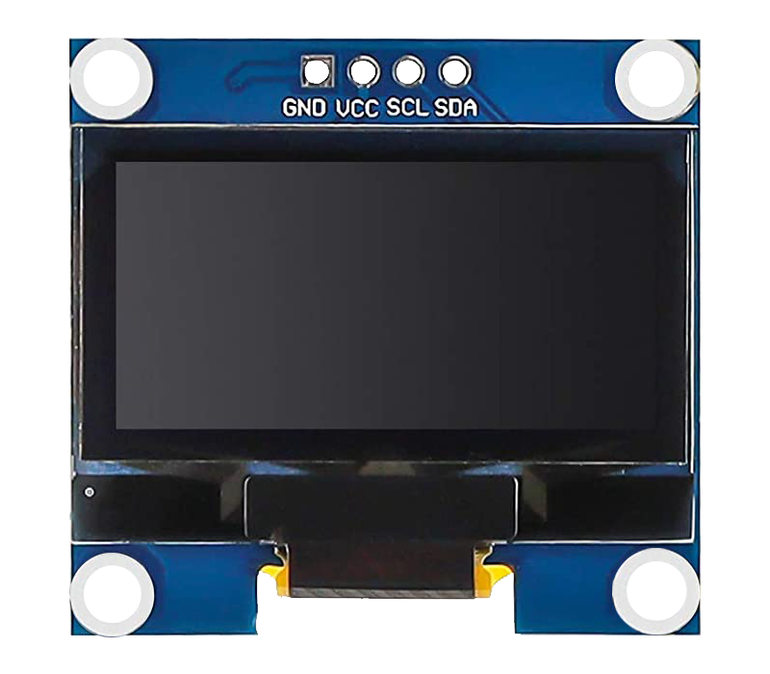
SFL12: POLLUTION SENSOR(MQ135) WITH OLED
Things Needed

Slide 4
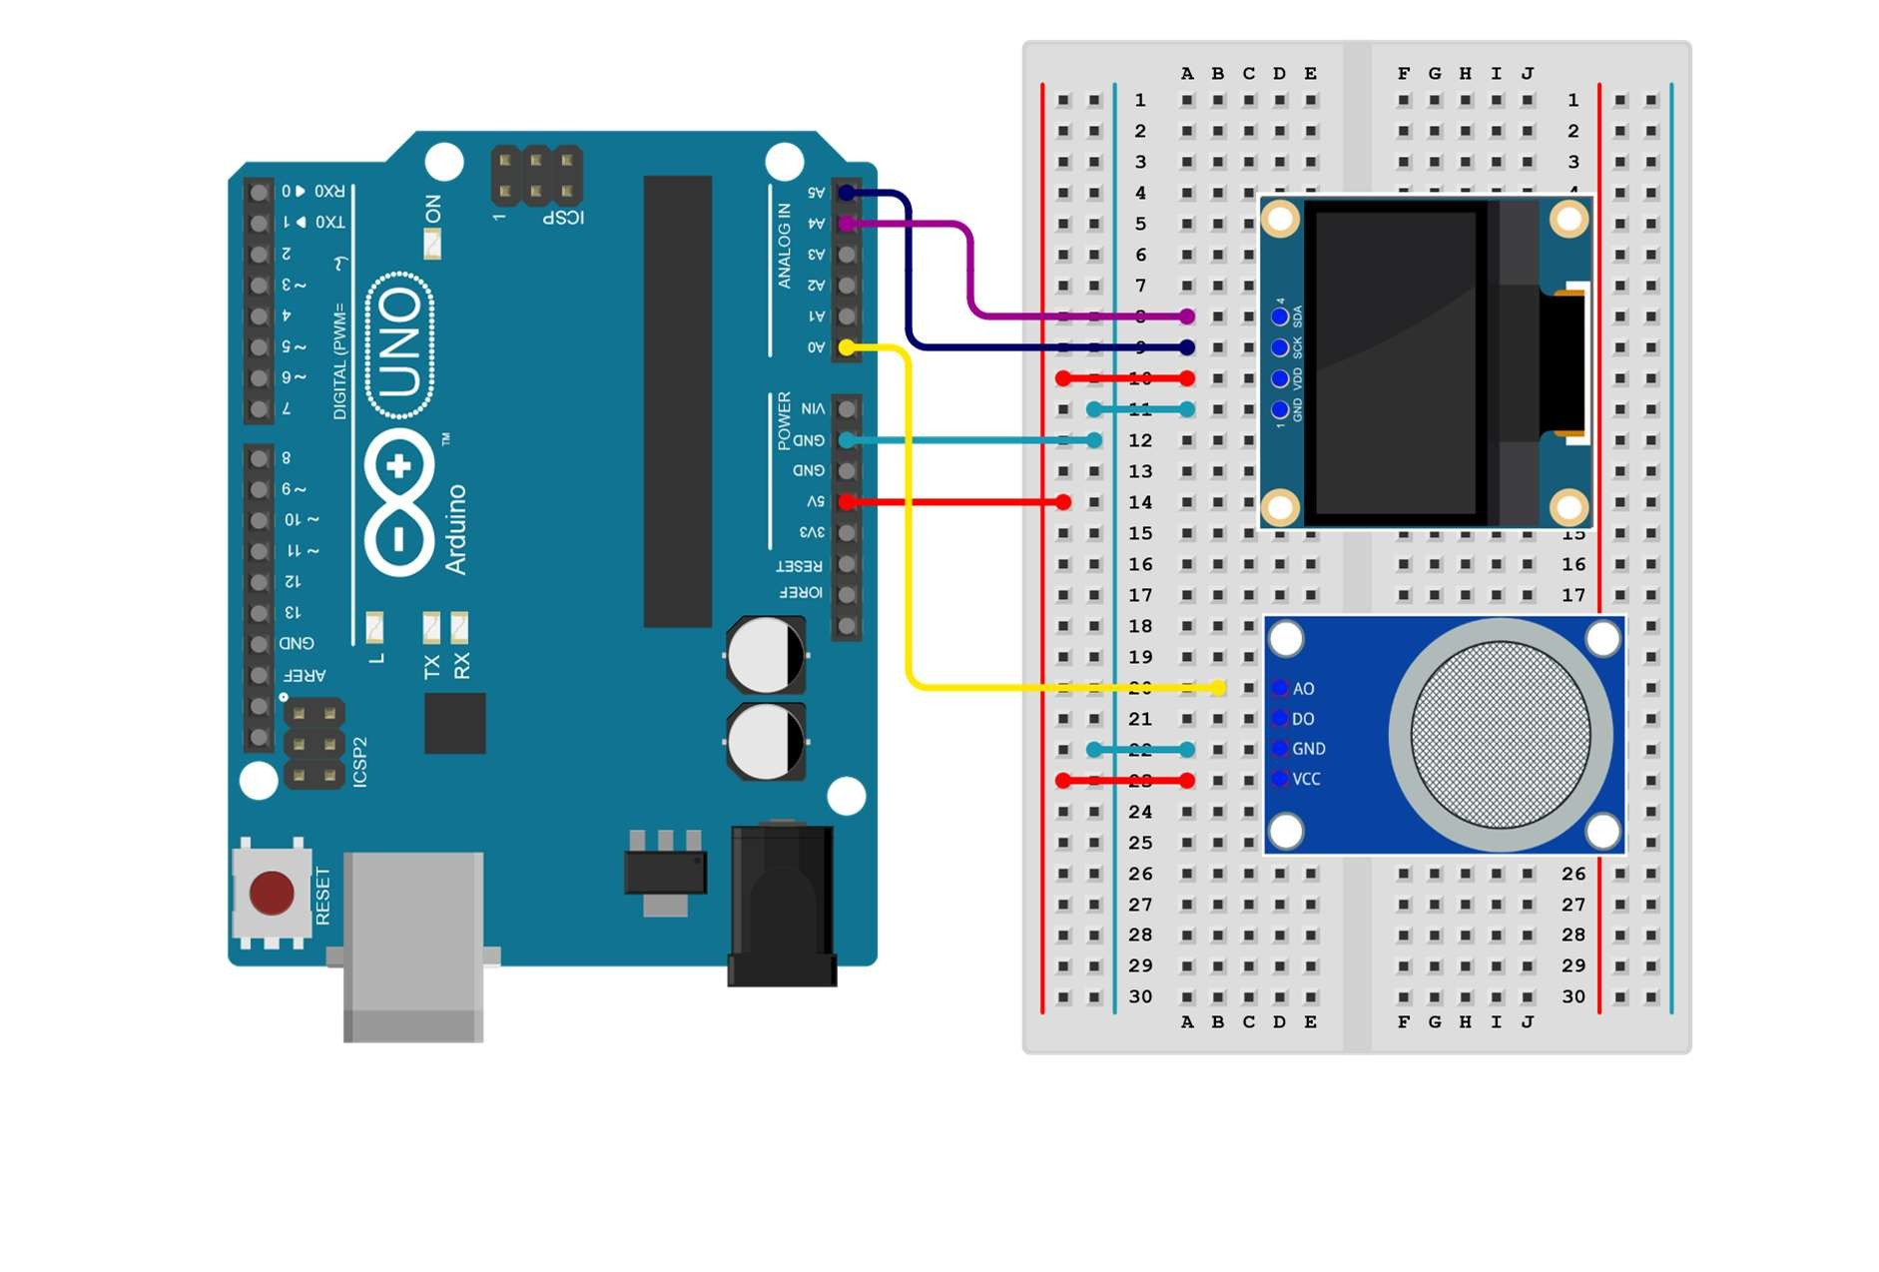
SFL12: POLLUTION SENSOR(MQ135) WITH OLED
Connections:
MQ135
Arduino pins | MQ135(Breadboard)
5V | VCC(RED LINE)
GND | GND(light blue line)
Analogue(A0) | A0(yellow line)
OLED
Arduino pins | OLED(breadboard)
5V | VCC(red line)
GND | GND(light blue line)
SDA | A4(purple line)
SCL | A5(dark blue line)

Slide 5
SFL12: POLLUTION SENSOR(MQ135) WITH OLED
Include library(OLED,GFX)
Setup
attach the MQ135 to A0 pin and OLED to A4,A5 and common VCC and GND pins
Loop()
the code reads the analog value from the MQ135 sensor, clears the display, and prints the sensor value on the OLED screen.
The display is updated every second.
Code for Lesson SFL12:
https://github.com/info-zas/zas-robotics-sensors/blob/main/01_FoundationProjects/01_Code/_13_MonitoringAirQualityUsingGasSensorAndOLED/_13_MonitoringAirQualityUsingGasSensorAndOLED.ino

Slide 6
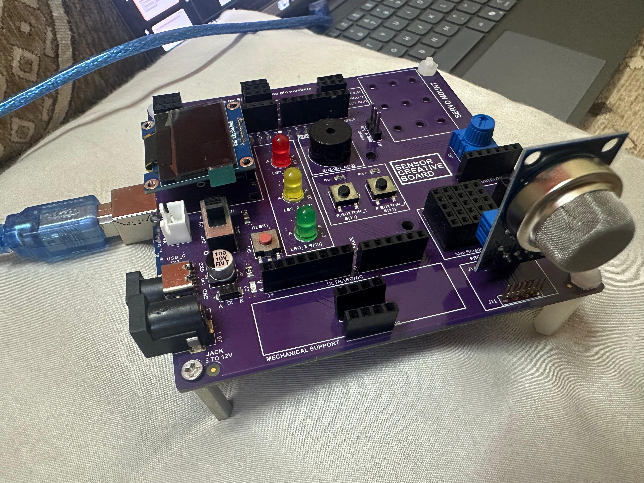
SFL12: POLLUTION SENSOR(MQ135) WITH OLED

Slide 7
SFL12: POLLUTION SENSOR(MQ135) WITH OLED

